Slide 1
Introduction to PDO

Slide 2
Objectives
Introduction to PDO
PreparedStatement
Exception in PDO

Slide 3
What is PDO
PHP 5 and later can work with a MySQL database using:
MySQLi extension (the "i" stands for improved)
PDO (PHP Data Objects)
Earlier versions of PHP used the MySQL extension. However, this extension was deprecated in 2012.
PDO is a PHP extension to formalize PHP's database connections by creating a uniform interface. This allows developers to create code which is portable across many databases and platforms

Slide 4
MySQLi or PDO?
Both MySQLi and PDO have their advantages:
PDO will work on 12 different database systems, whereas MySQLi will only work with MySQL databases.
So, if you have to switch your project to use another database, PDO makes the process easy. You only have to change the connection string and a few queries. With MySQLi, you will need to rewrite the entire code - queries included.
Both are object-oriented, but MySQLi also offers a procedural API.
Both support Prepared Statements. Prepared Statements protect from SQL injection, and are very important for web application security.

Slide 5
Introduction to PDO
The PHP Data Objects (PDO) extension defines a lightweight, consistent interface for accessing databases in PHP. Each database driver that implements the PDO interface can expose database-specific features as regular extension functions.
Note that you cannot perform any database functions using the PDO extension by itself; you must use a database-specific PDO driver to access a database server.
PDO provides a data-access abstraction layer, which means that, regardless of which database you're using, you use the same functions to issue queries and fetch data.
PDO does not provide a database abstraction; it doesn't rewrite SQL or emulate missing features. You should use a full-blown abstraction layer if you need that facility.

Slide 6
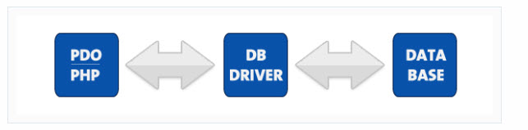
Introduction to OOP
PDO ships with PHP 5.1, and is available as a PECL extension for PHP 5.0; PDO requires the new OO features in the core of PHP 5, and so will not run with earlier versions of PHP.

Slide 7

Database Support
The extension can support any database that a PDO driver has been written for. The following database drivers are available:
PDO_DBLIB ( FreeTDS / Microsoft SQL Server / Sybase )
PDO_FIREBIRD ( Firebird/Interbase 6 )
PDO_IBM ( IBM DB2 )
PDO_INFORMIX ( IBM Informix Dynamic Server )
PDO_MYSQL ( MySQL 3.x/4.x/5.x )
PDO_OCI ( Oracle Call Interface )
PDO_ODBC ( ODBC v3 (IBM DB2, unixODBC and win32 ODBC) )
PDO_PGSQL ( PostgreSQL )
PDO_SQLITE ( SQLite 3 and SQLite 2 )
PDO_4D ( 4D )
All of these drivers are not necessarily available on your system; here's a quick way to find out which drivers you have:

Slide 8

Connecting to MySQL
Connections are established by creating instances of the PDO base class. It doesn't matter which driver you want to use; you always use the PDO class name. The constructor accepts parameters for specifying the database source (known as the DSN) and optionally for the username and password (if any).
If there are any connection errors, a PDOException object will be thrown. You may catch the exception if you want to handle the error condition, or you may opt to leave it for an application global exception handler that you set up via set_exception_handler().

Slide 9
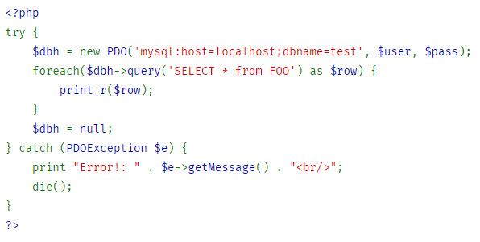
Connecting to MySQL
Upon successful connection to the database, an instance of the PDO class is returned to your script. The connection remains active for the lifetime of that PDO object.
To close the connection, you need to destroy the object by ensuring that all remaining references to it are deleted—you do this by assigning NULL to the variable that holds the object. If you don't do this explicitly, PHP will automatically close the connection when your script ends.

Slide 10
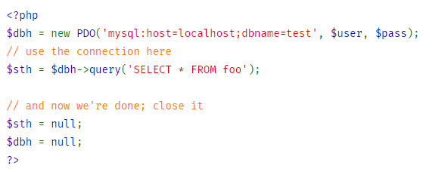
Closing a connection

Slide 11
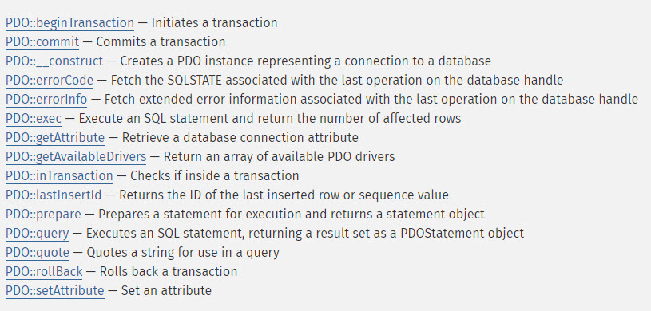
The PDO class
Represents a connection between PHP and a database server.
Methods:

Slide 12
Prepared statements
A kind of compiled template for the SQL that an application wants to run, that can be customized using variable parameters.
Prepared statements offer two major benefits:
The query only needs to be parsed (or prepared) once, but can be executed multiple times with the same or different parameters. When the query is prepared, the database will analyze, compile and optimize its plan for executing the query. For complex queries this process can take up enough time that it will noticeably slow down an application if there is a need to repeat the same query many times with different parameters. By using a prepared statement the application avoids repeating the analyze/compile/optimize cycle. This means that prepared statements use fewer resources and thus run faster.
The parameters to prepared statements don't need to be quoted; the driver automatically handles this. If an application exclusively uses prepared statements, the developer can be sure that no SQL injection will occur

Slide 13
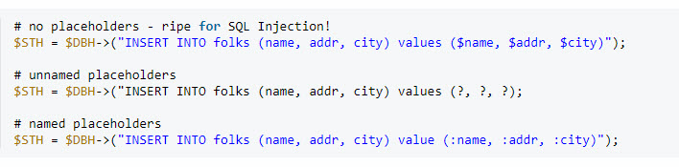
Prepared statements
You use a prepared statement by including placeholders in your SQL. Here's three examples: one without placeholders, one with unnamed placeholders, and one with named placeholders.

Slide 14
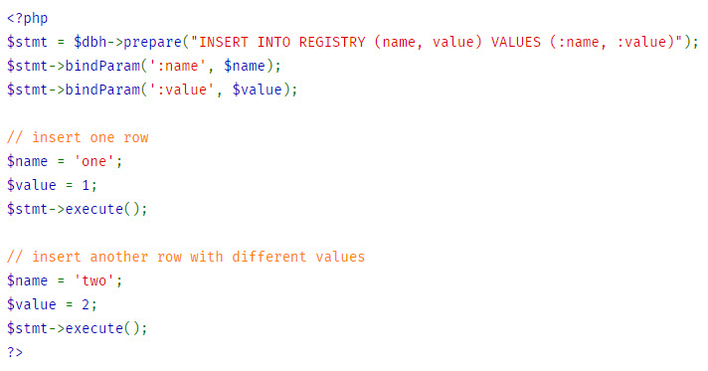
Example
This example performs an INSERT query by substituting a name and a value for the named placeholders.

Slide 15
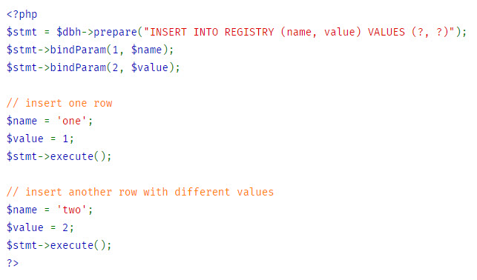
Example
This example performs an INSERT query by substituting a name and a value for the positional ? placeholders.

Slide 16
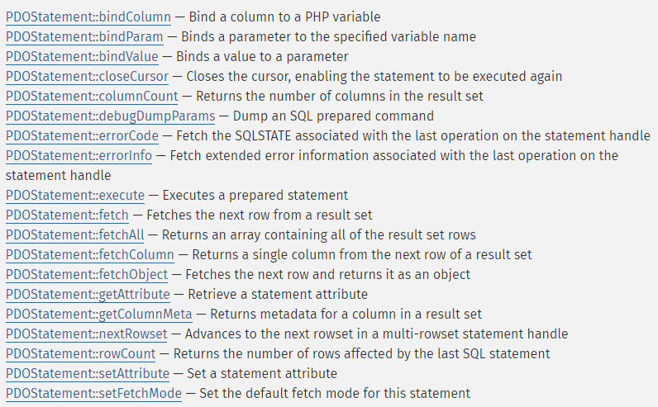
The PDOStatement class
Represents a prepared statement and, after the statement is executed, an associated result set.
Methods:

Slide 17
Demo
Teacher demo code about connect to database with PDO

Slide 18
Some Other Helpful Methods
lastInsertId() method
Is always called on the database handle, not statement handle, and will return the auto incremented id of the last inserted row by that connection.
exec() method
Is used for operations that can not return data other then the affected rows.
rowCount() method
Returns an integer indicating the number of rows affected by an operation.

Slide 19

Exceptions and PDO
PDO can use exceptions to handle errors, which means anything you do with PDO should be wrapped in a try/catch block.
You can force PDO into one of three error modes by setting the error mode attribute on your newly created database handle.
No matter what error mode you set, an error connecting will always produce an exception, and creating a connection should always be contained in a try/catch block.
Example:

Slide 20
Exceptions and PDO
PDO::ERRMODE_SILENT
This is the default error mode. If you leave it in this mode, you'll have to check for errors in the way you're probably used to if you used the mysql or mysqli extensions. The other two methods are more ideal for DRY programming.
PDO::ERRMODE_WARNING
This mode will issue a standard PHP warning, and allow the program to continue execution. It's useful for debugging.
PDO::ERRMODE_EXCEPTION
This is the mode you should want in most situations. It fires an exception, allowing you to handle errors gracefully and hide data that might help someone exploit your system.

Slide 21
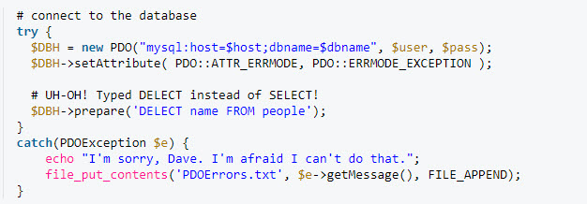
Exceptions and PDO
Example:
Note: A great benefit of PDO is that it has an exception class to handle any problems that may occur in our database queries. If an exception is thrown within the try{ } block, the script stops executing and flows directly to the first catch(){ } block.

Slide 22
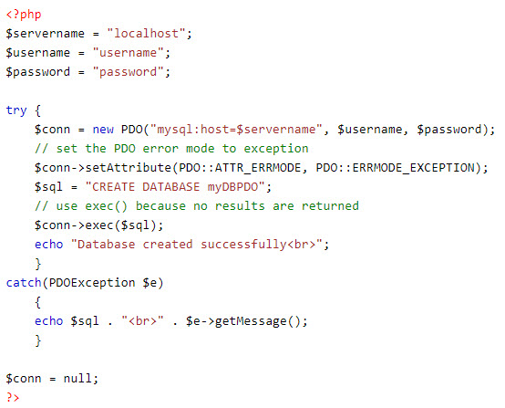
Create database
Example create database in PDO:

Slide 23
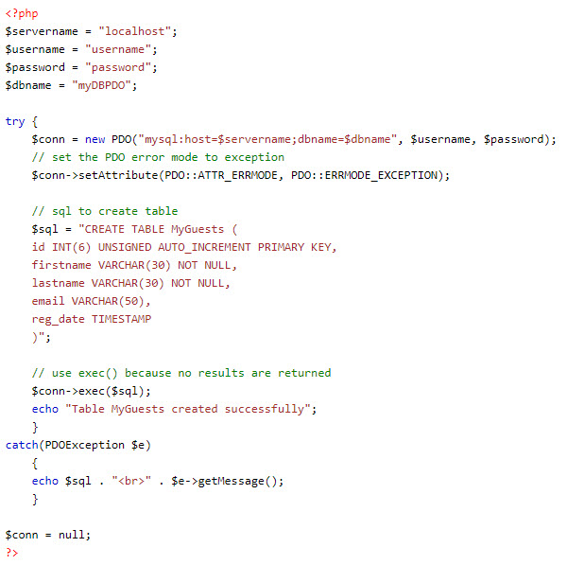
Create table
Example create table in PDO:

Slide 24
Demo
Teacher demo code about database operation using PDO

Slide 25
Summary
Introduction to PDO
PreparedStatement
Exception in PDO

